Slide 1


Computer Applications to Behavioral Sciences
Lecture 3. Conditional
何吉波，博士
清华大学用户体验学科负责人
优视眼动科技公司创始人
http://www.usee.tech

Slide 2
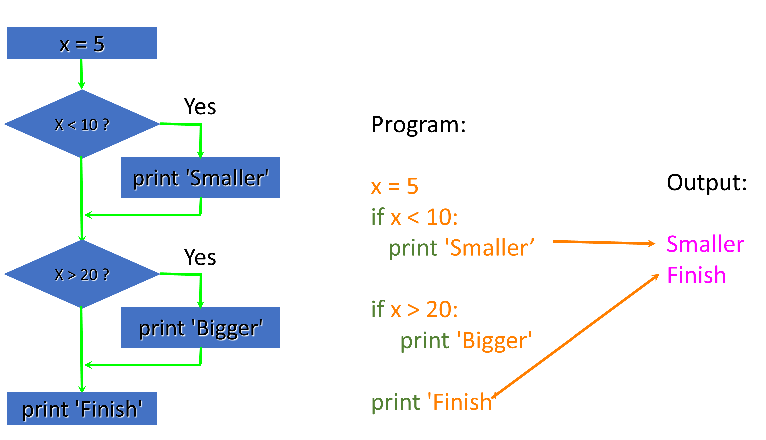
Conditional Steps

Slide 3
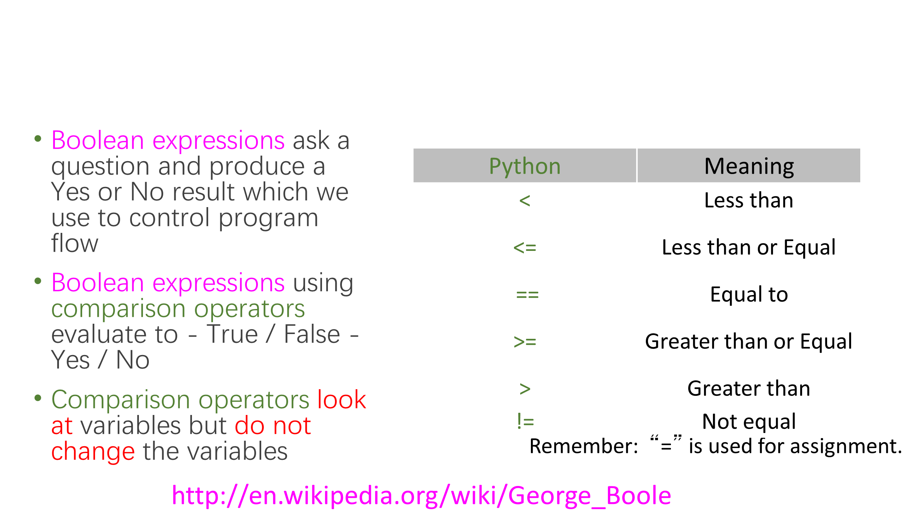
Comparison Operators

Slide 4
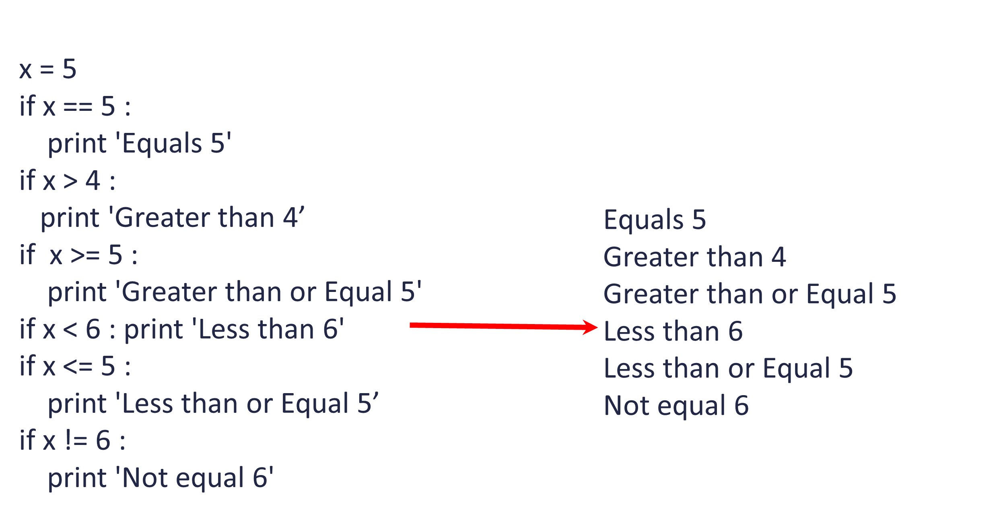
Comparison Operators

Slide 5
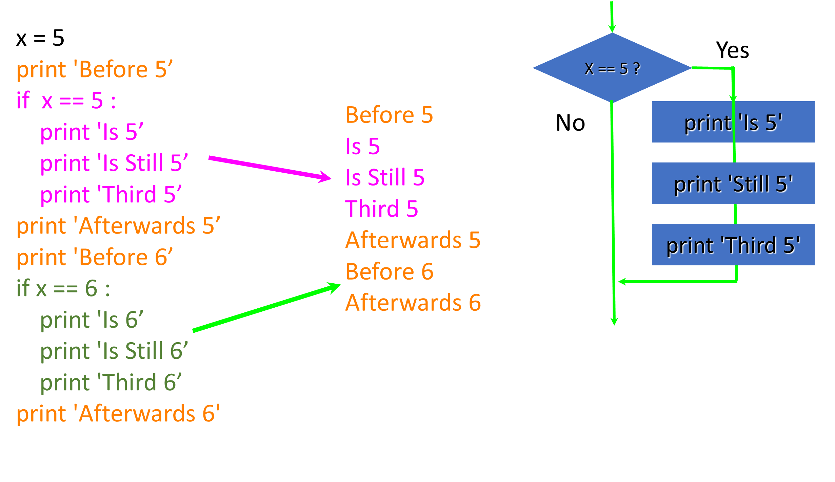
One-Way Decisions

Slide 6
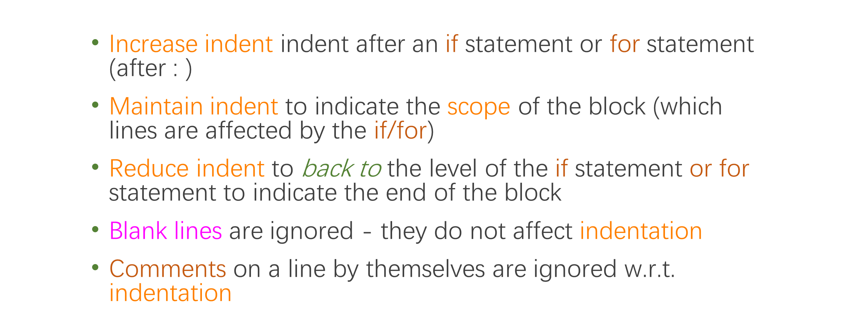
Indentation

Slide 7
Warning: Turn Off Tabs
Most text editors can turn tabs into spaces - make sure to enable this feature
NotePad++: Settings -> Preferences -> Language Menu/Tab Settings
Python cares a *lot* about how far line is indented. If you mix tabs and spaces, you may get “indentation errors” even if everything looks fine

Slide 8
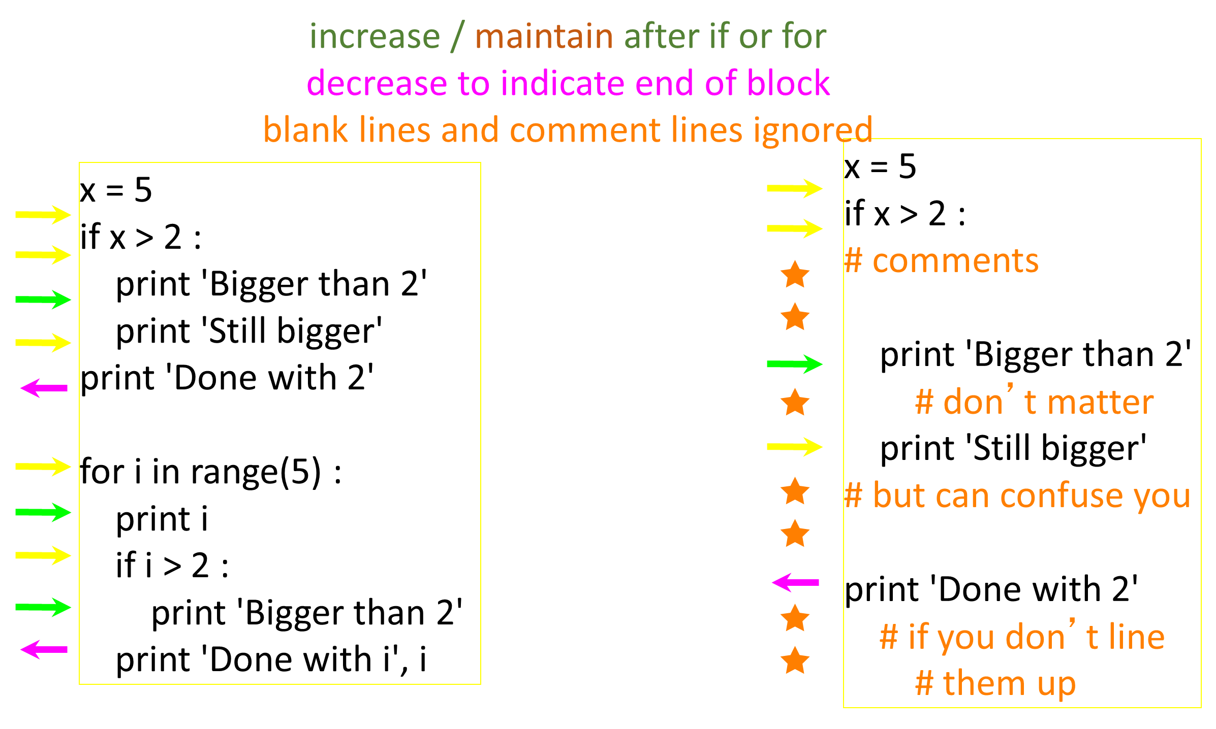

Slide 9
Conditional Steps
x = 5
if x > 2 :
# comments
print（'Bigger than 2'）
# don’t matter
print（'Still bigger'）
# but can confuse you
print（'Done with 2'）
# if you don’t line
# them up
x = 5
if x > 2 :
print('Bigger than 2')
print('Still bigger')
print('Done with 2')
for i in range(5) :
print(i)
if i > 2 :
print('Bigger than 2')
print 'Done with i', i

Slide 10
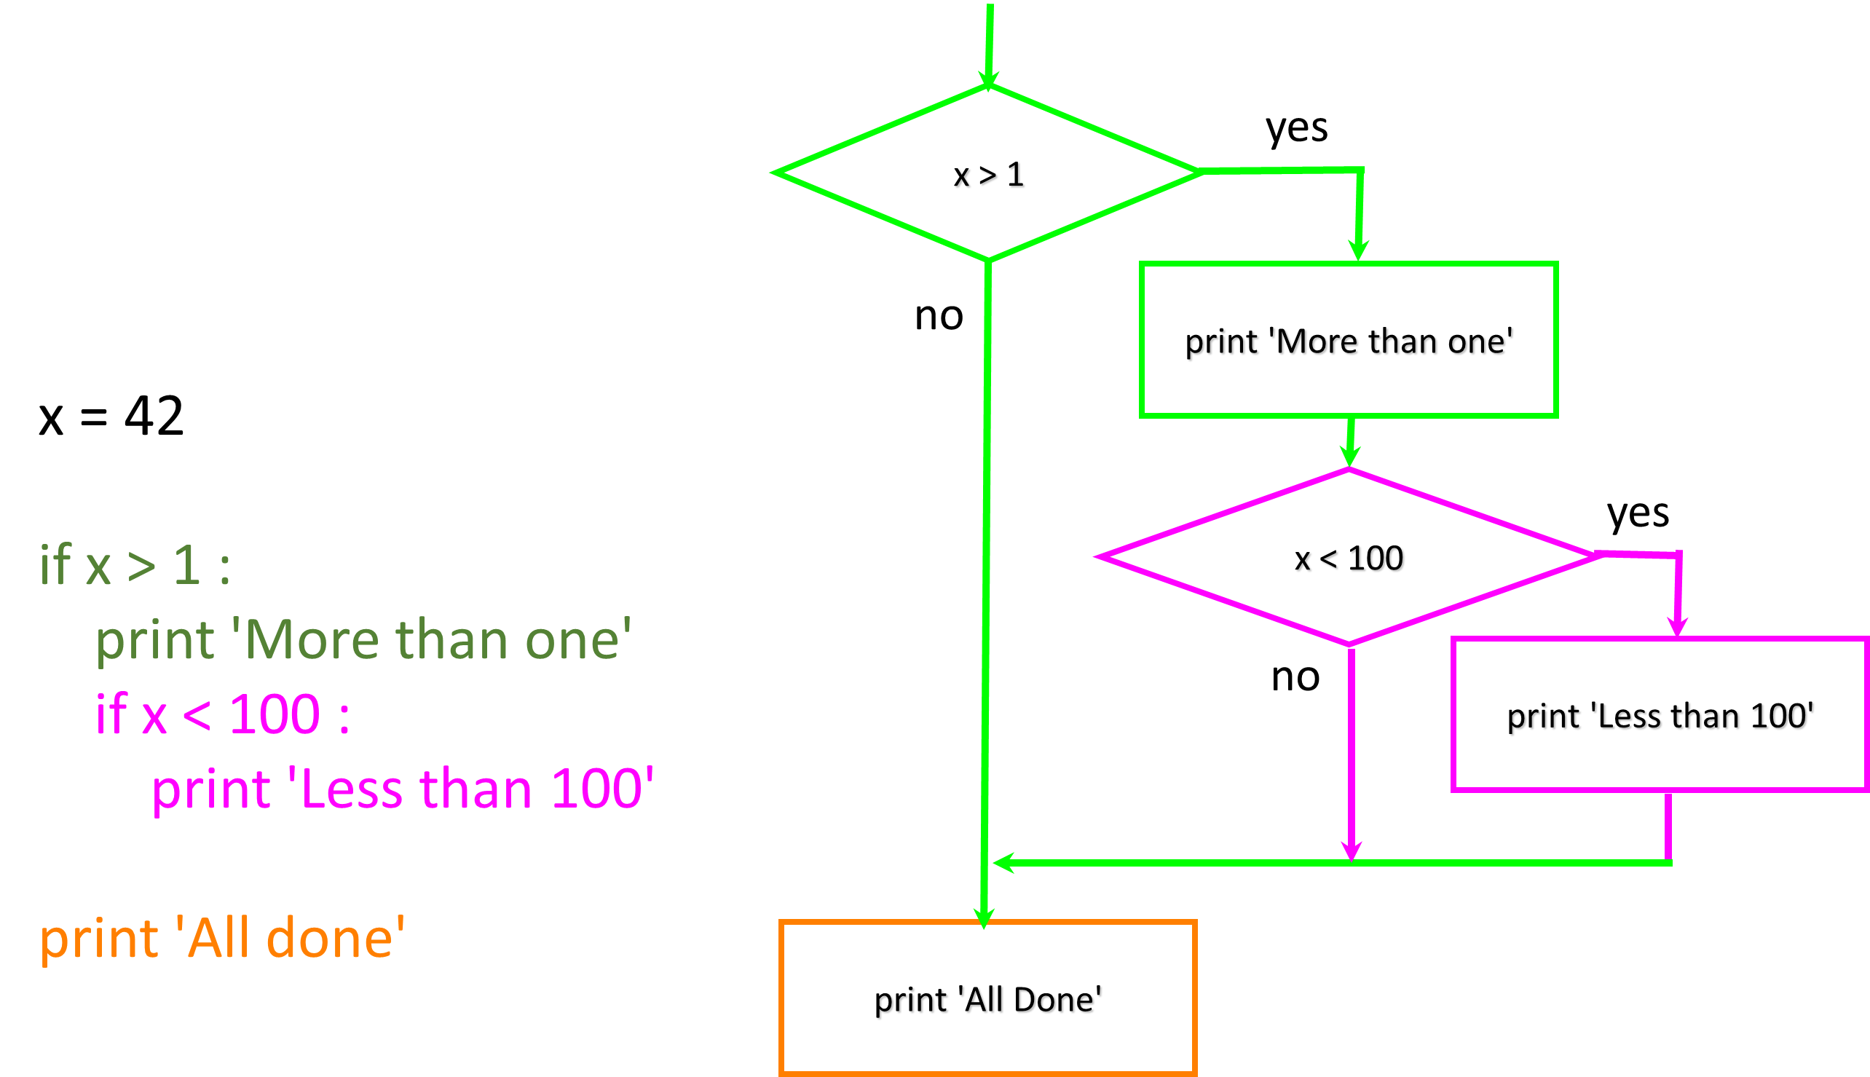
Nested Decisions

Slide 11
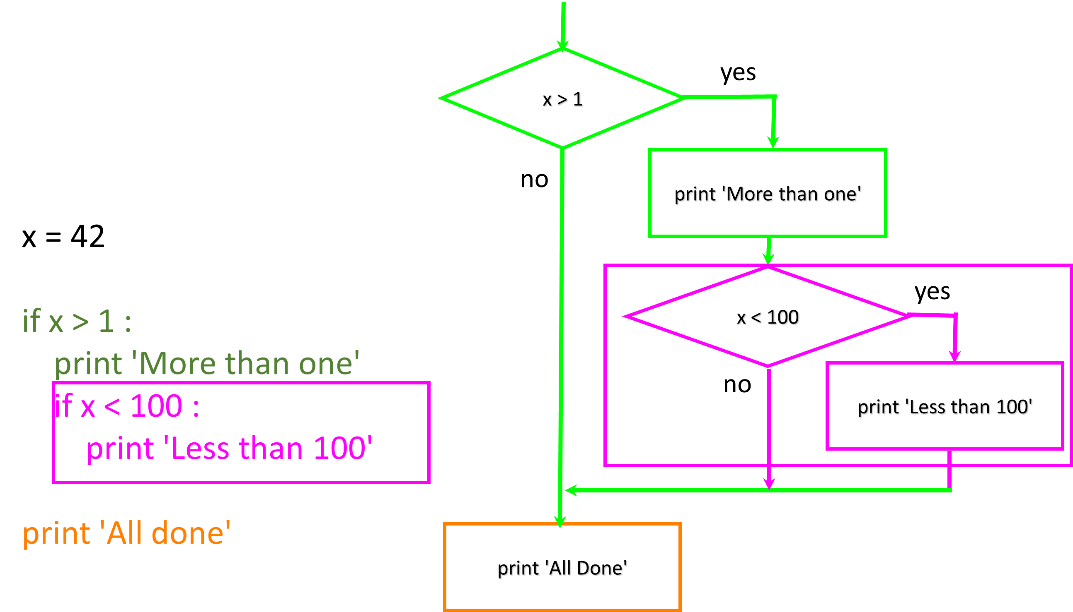
Nested Decisions

Slide 12
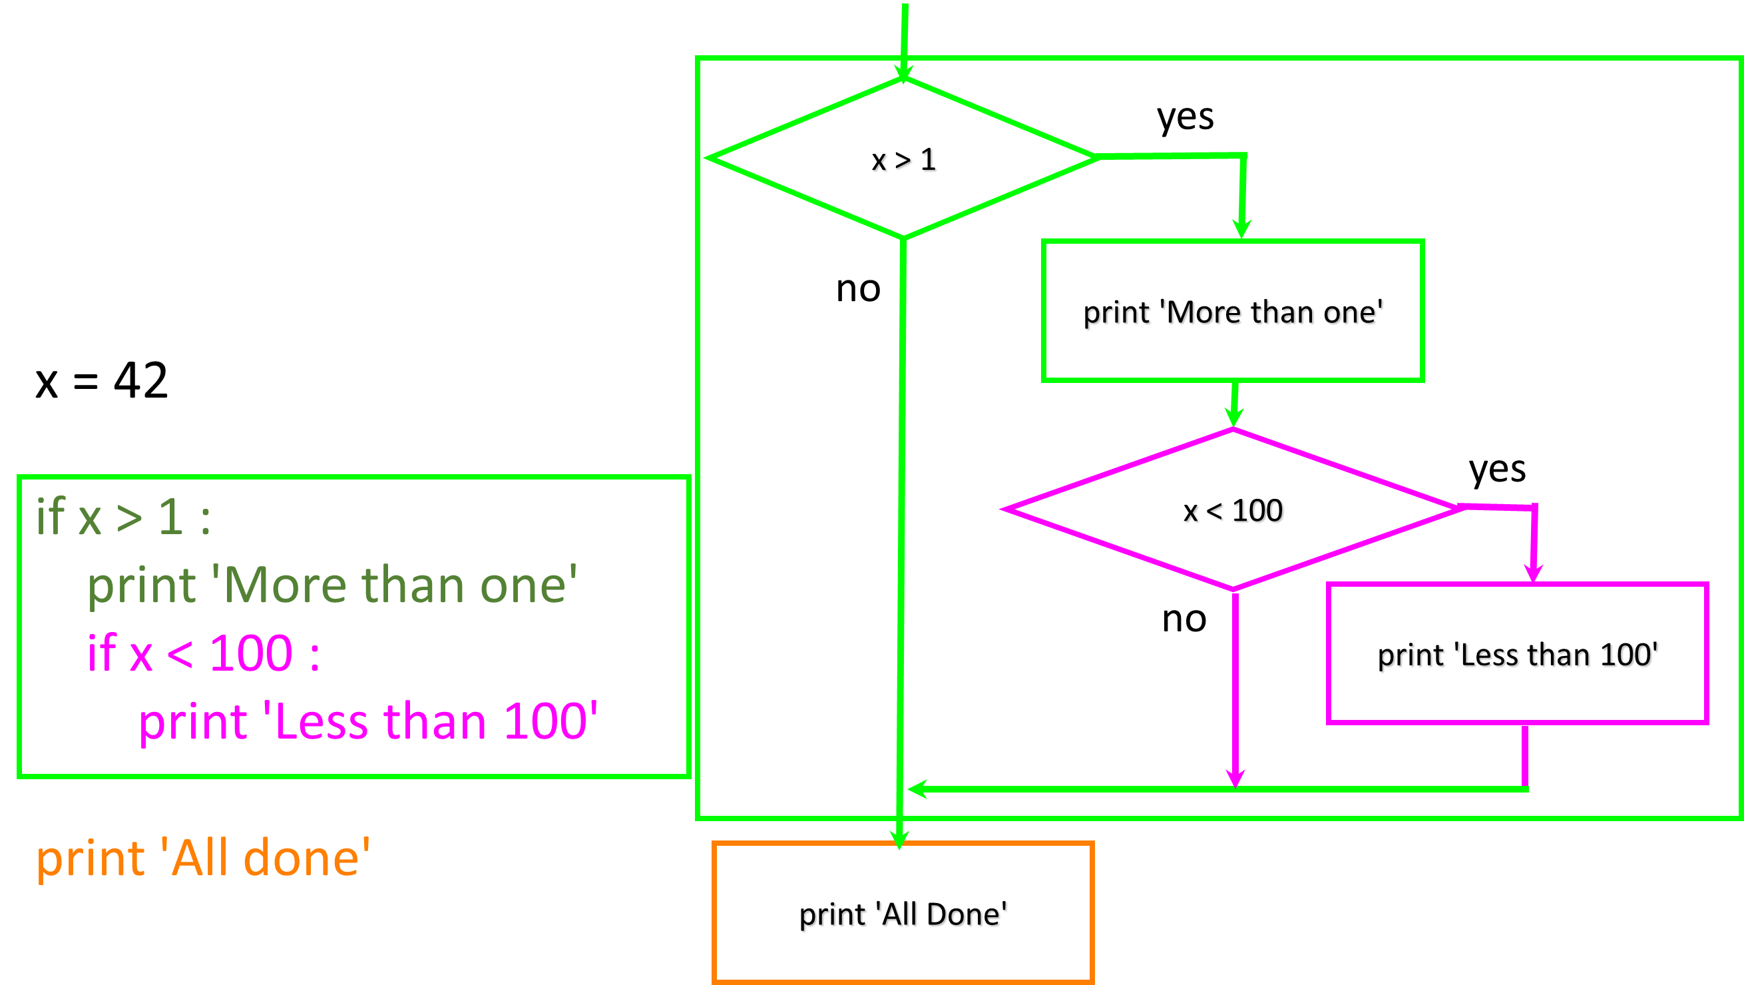
Nested Decisions

Slide 13
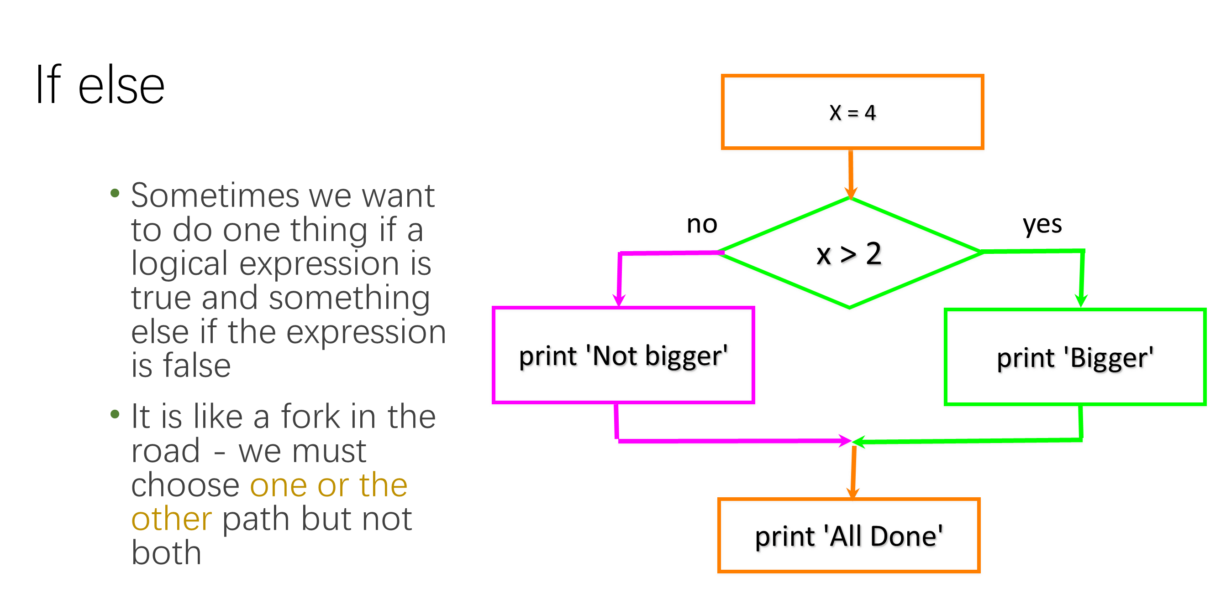

Slide 14
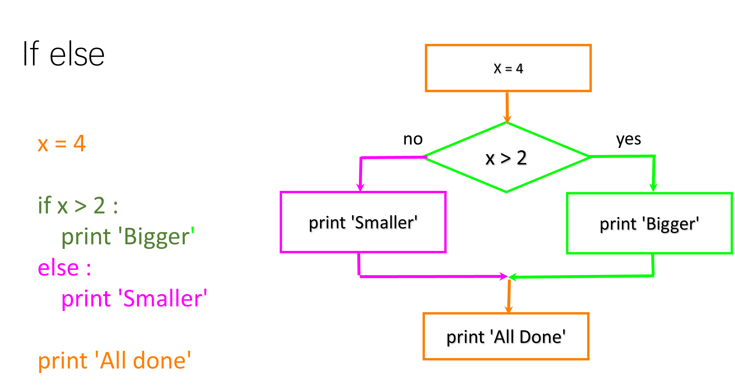

Slide 15
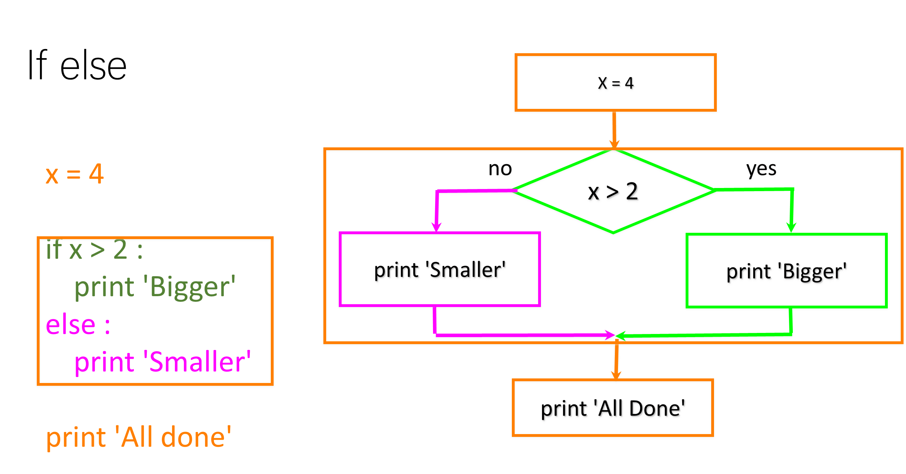

Slide 16
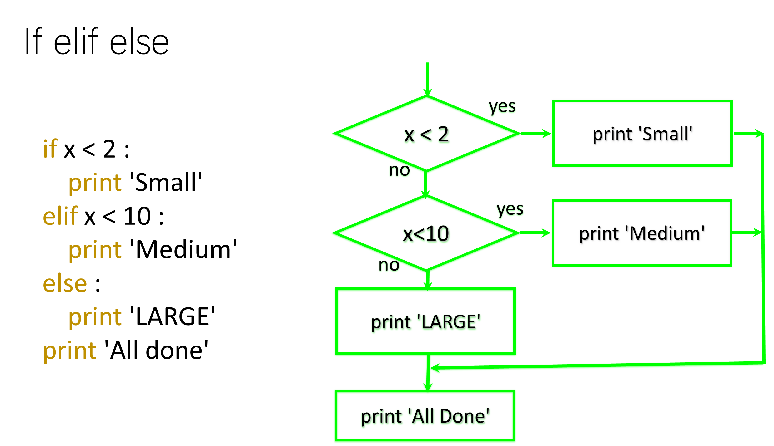

Slide 17
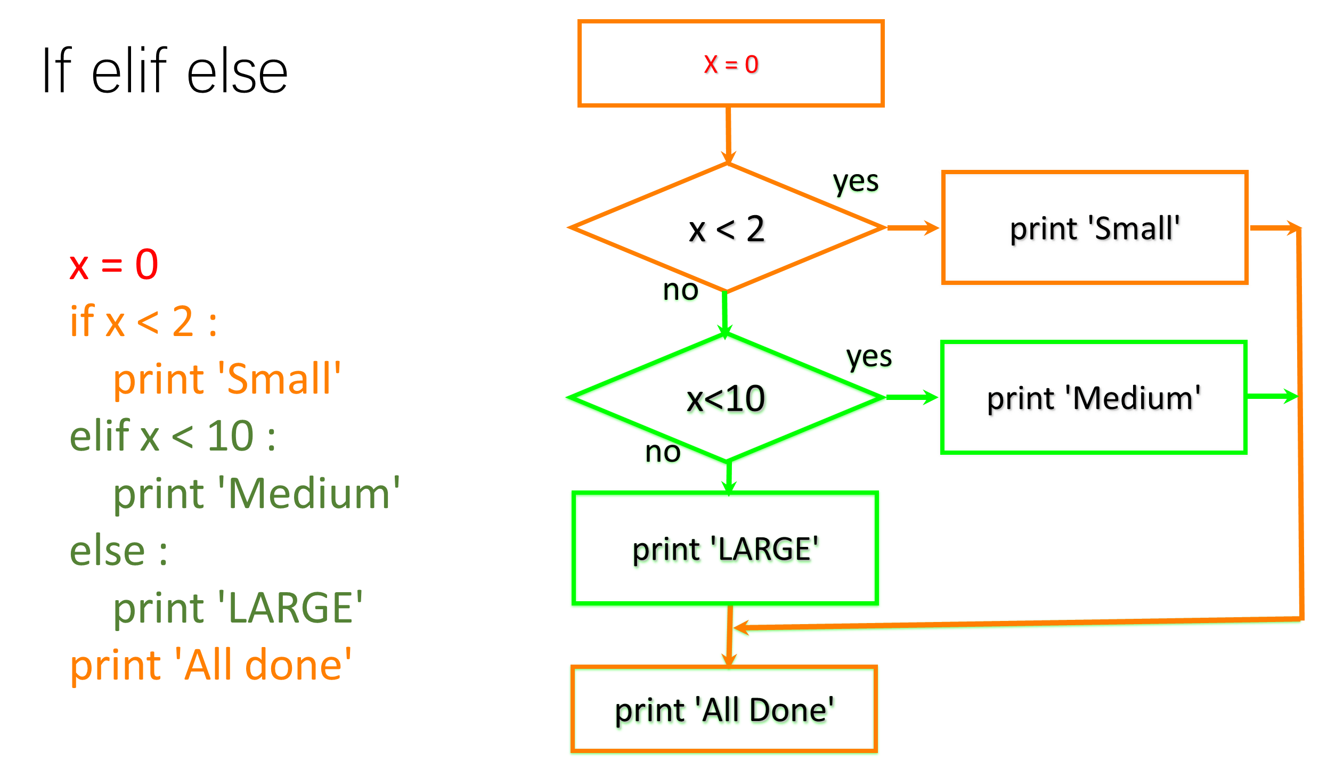

Slide 18
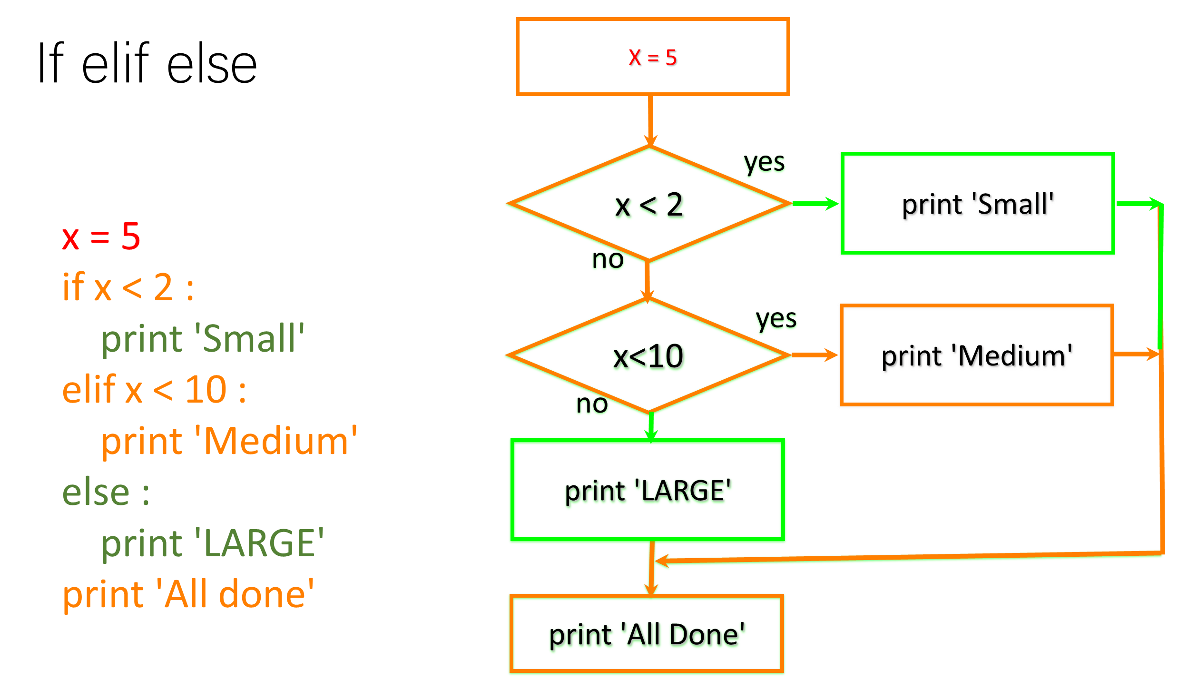

Slide 19
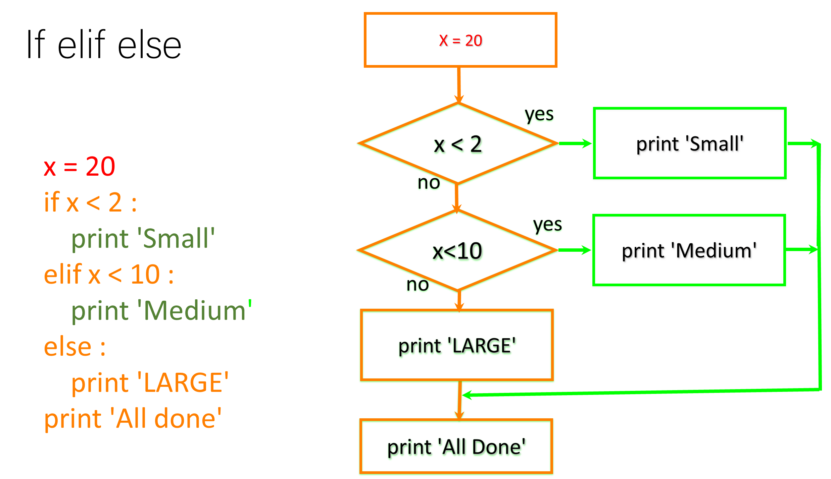

Slide 20
# No Else
x = 5
if x < 2 :
print('Small')
elif x < 10 :
print('Medium')
print('All done')
if x < 2 :
print('Small')
elif x < 10 :
print('Medium')
elif x < 20 :
print('Big')
elif x< 40 :
print('Large')
elif x < 100:
print('Huge')
else :
print('Ginormous')

Slide 21
Multi-way Puzzles
if x < 2 :
print('Below 2')
elif x >= 2 :
print('Two or more')
else :
print('Something else')
if x < 2 :
print('Below 2')
elif x < 20 :
print('Below 20')
elif x < 10 :
print('Below 10')
else :
print('Something else')

Slide 22
The try / except Structure
You surround a dangerous section of code with try and except.
If the code in the try works - the except is skipped
If the code in the try fails - it jumps to the except section

Slide 23
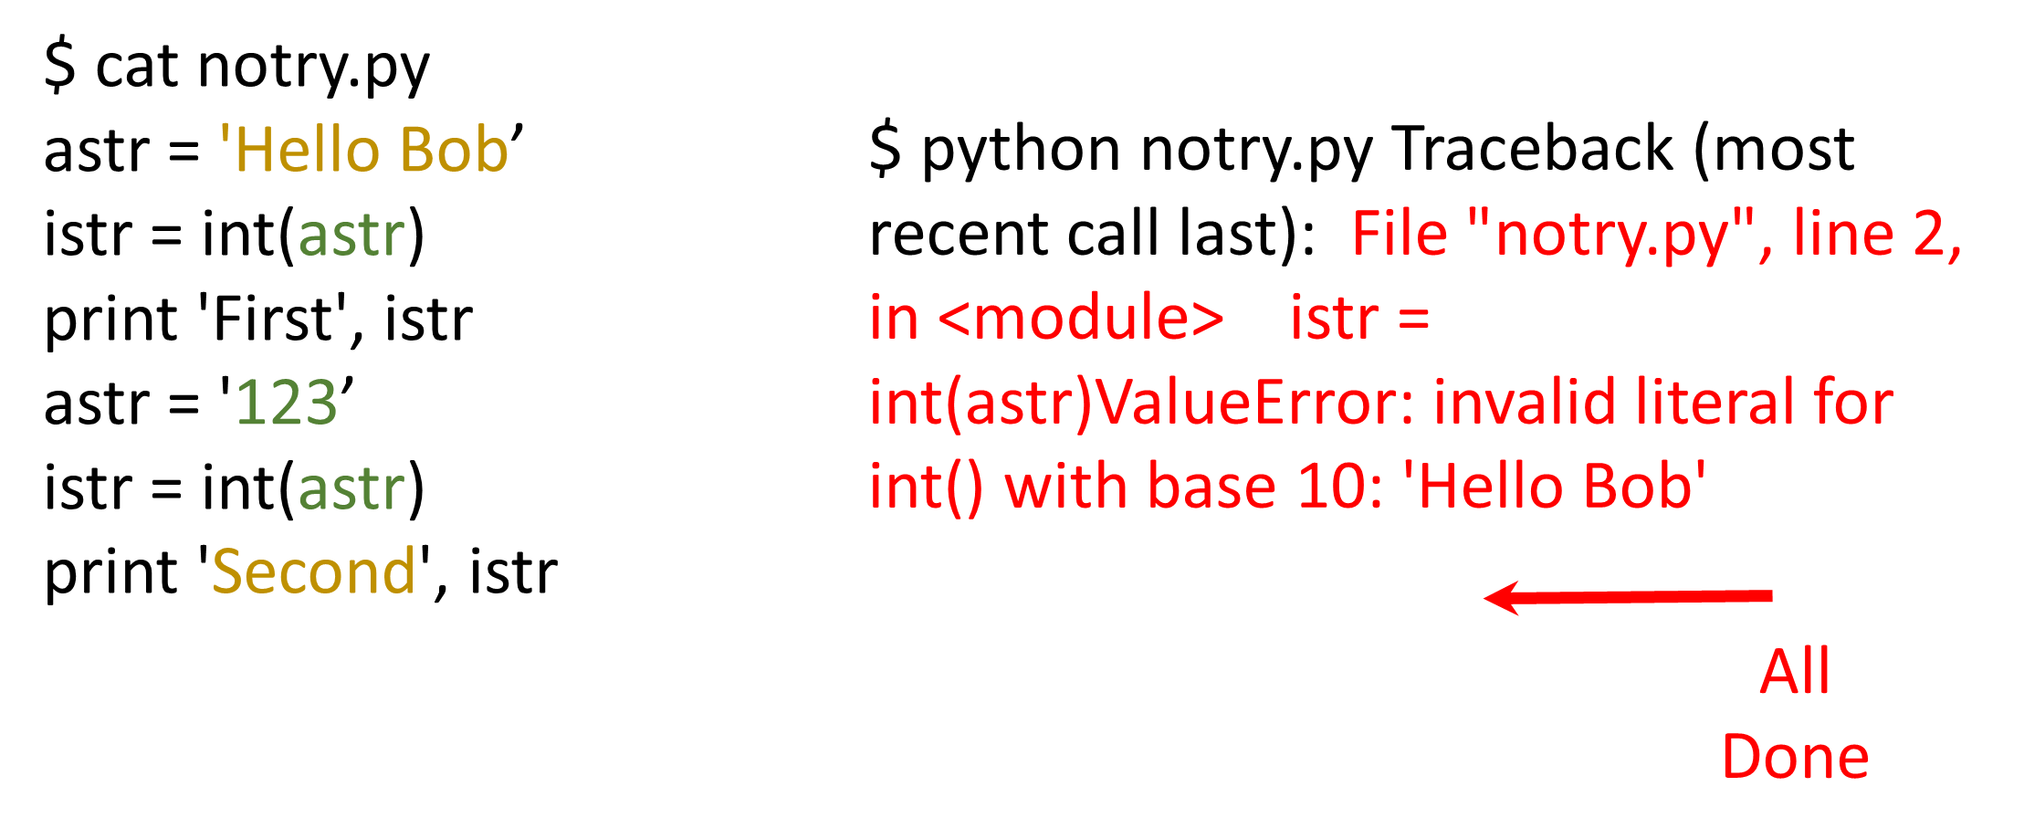

Slide 24
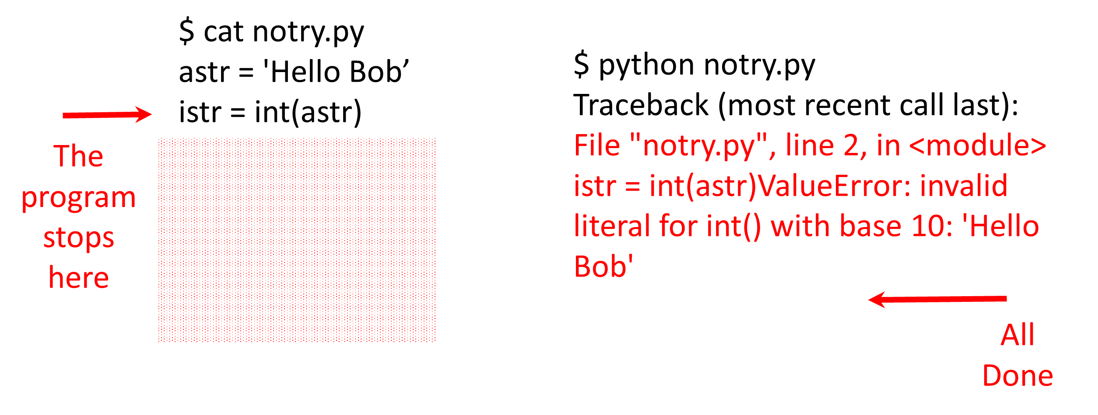

Slide 25
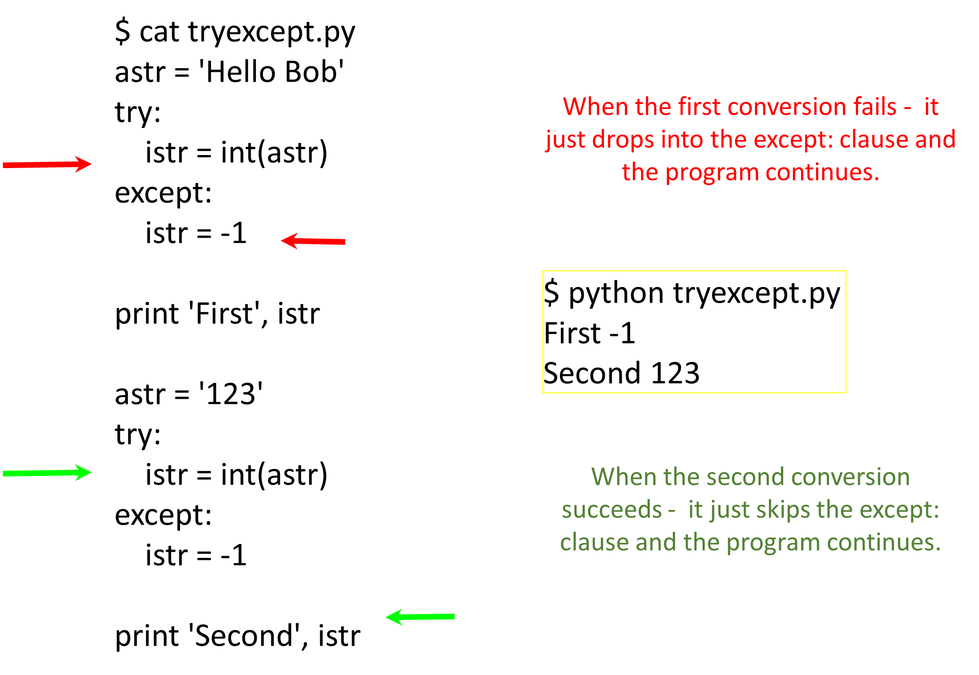

Slide 26
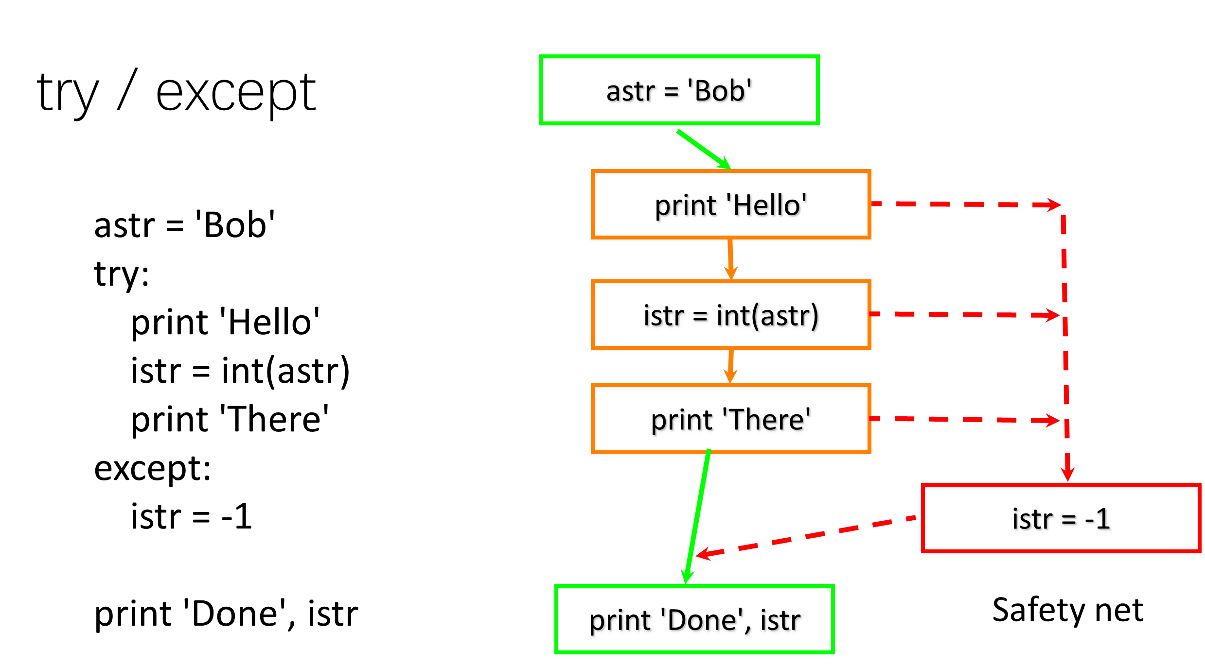

Slide 27
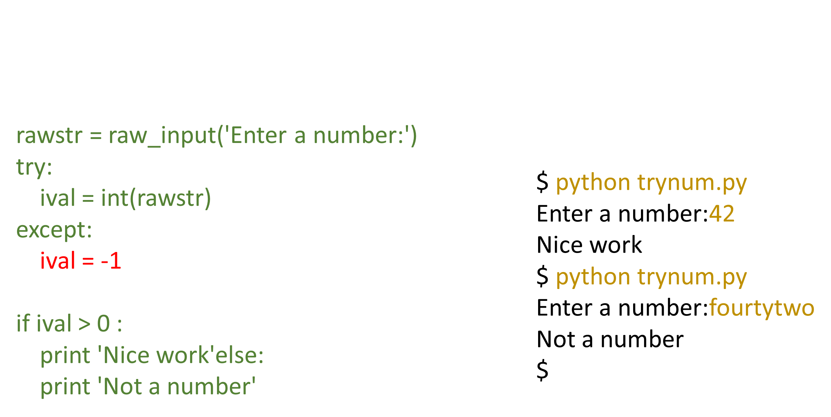
Sample try / except

Slide 28


Slide 29
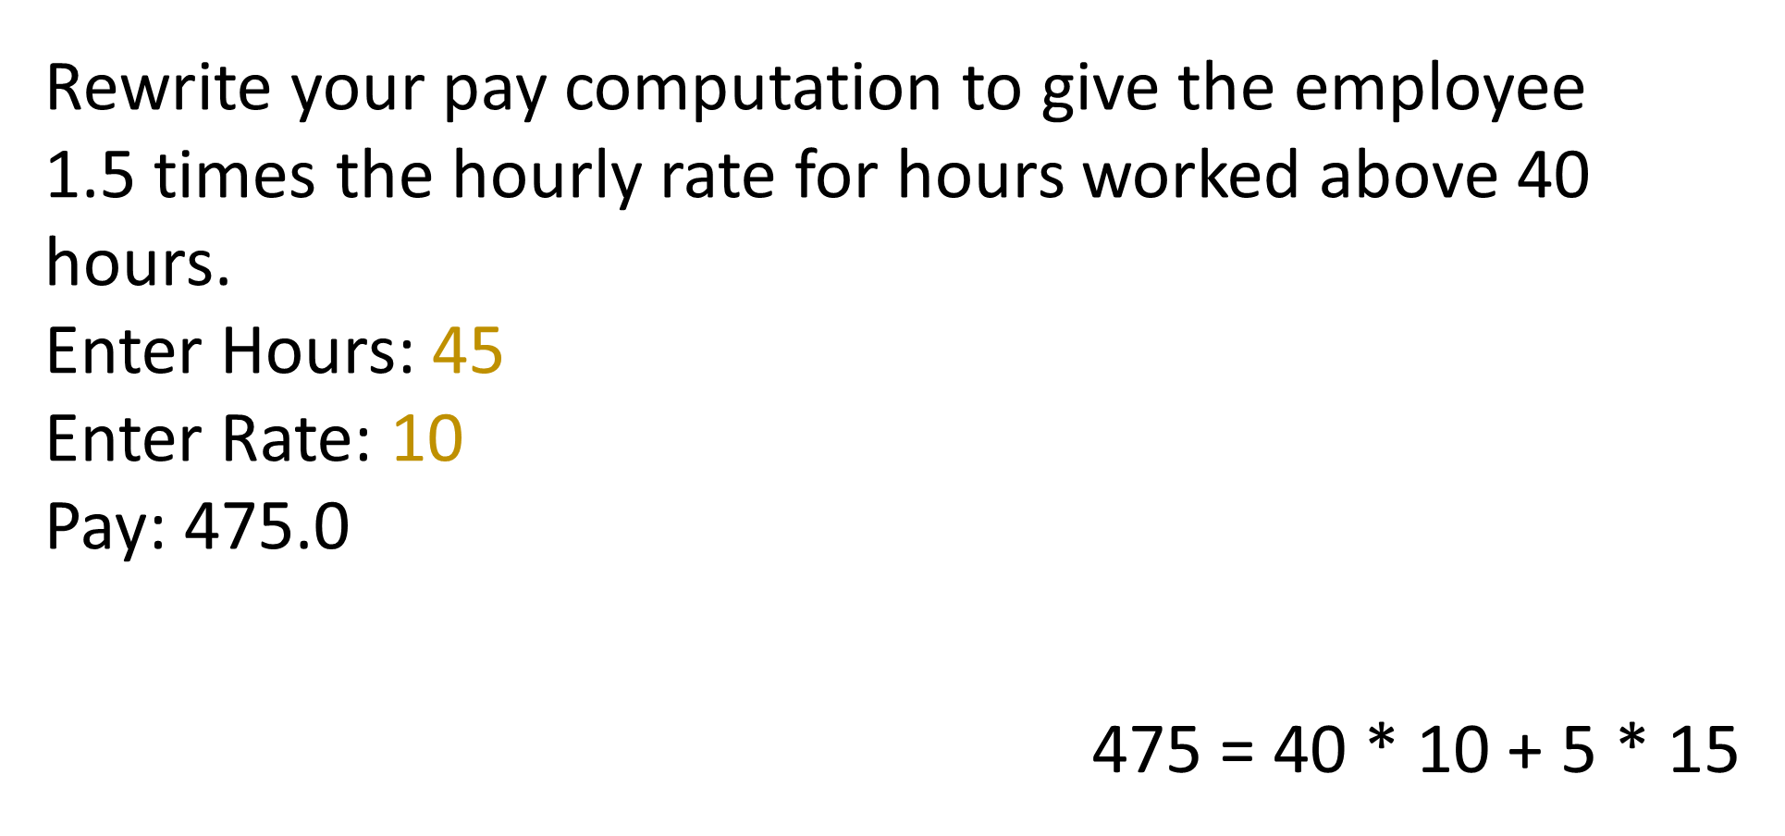
Exercise

Slide 30
Summary
Comparison operators == <= >= > < !=
Logical operators: and or not
Indentation
One Way Decisions
Two way Decisions if : and else :
Nested Decisions
Multiway decisions using elif
Try / Except to compensate for errors

Slide 31
Thank You

